Slide 1
Neural Network Prediction of NYSERDA PV Incentive Funds

Slide 2

Agenda
Problem & Predictions
Data Analysis Process
Results
Limitations
Recommendations
Benefits

Slide 3

Who AM I?

Slide 4

Chris Kamper
MSDA Student at WGU, expected graduation April 2024.
Interest in data and analytics since undergraduate studies.
Experience working with data through academics and professional career.
Looking to further gain knowledge and experience in all aspects of data science, analytics, and engineering.
Has the perfect last name, really enjoys camping!

Slide 5

Problem & Predictions

Slide 6
Research question & Hypothesis
Research Question:
Do the Project Cost and Expected KWh Annual Production variables have a significant impact on incentive amounts to be used to predict a high or low amount for a PV project under the NYSERDA program?
Hypothesis:
A statistically significant predictive model can be built from the Project Cost and Expected KWh Annual Production variables to predict the incentive amount as high or low.

Slide 7

Data Analysis Process

Slide 8

Data ColleCtion
Sourced from New York State Energy Research and Development through NY Open Data Program: https://data.ny.gov/Energy-Environment/Solar-Electric-Programs-Reported-by-NYSERDA-Beginn/3x8r-34rs/about_data
Collected from the March 2024 update.
(NY Open Data)

Slide 9
Preparation
1. Remove any variables not needed.
2. Remove any duplicated values based on a unique ID.
3. Remove any null values.
4. Create and calculate a new categorical variable defining the low and high categories of incentive dollars.
 | Project Number | Project Cost | Total NYSERDA Incentive | Expected KWh Annual Production | Incentive Category
0 | 691293 | 25476.01 | 880 | 5131 | 0
1 | 713651 | 14499 | 1440 | 7986 | 0
2 | 580034 | 41006 | 3038 | 12517 | 1
3 | 715572 | 18025 | 1012 | 5991 | 0
4 | 457787 | 0 | 3375 | 0 | 1

Slide 10
Exploratory Analysis
1. Review the statistics of each variable to be used in the model.
 | Project Cost | Total NYSERDA Incentive | Expected KWh Annual Production
Mean | 9,495 | 1,689 | 5,894
Min | 0 | 0 | 0
Max | 26,420,000 | 601,250 | 1,165,000
Median | 31,164 | 2,545 | 7,773

Slide 11
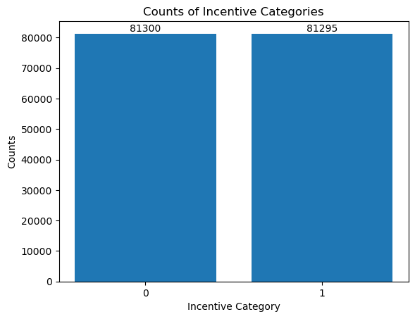
Exploratory Analysis
2. Review the breakdown of how many values fall into each category.

Slide 12
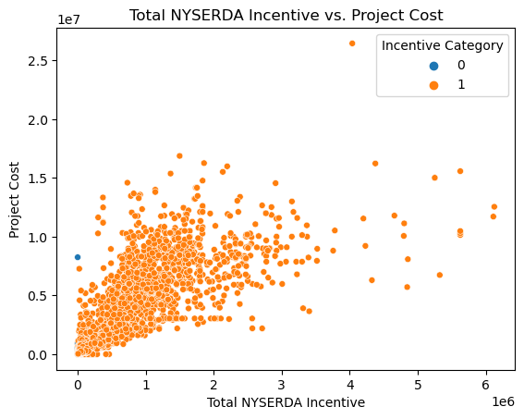
Exploratory Analysis
3. Review the relationship of the Project Cost variable versus the Total NYSERDA Incentive based on the category.

Slide 13
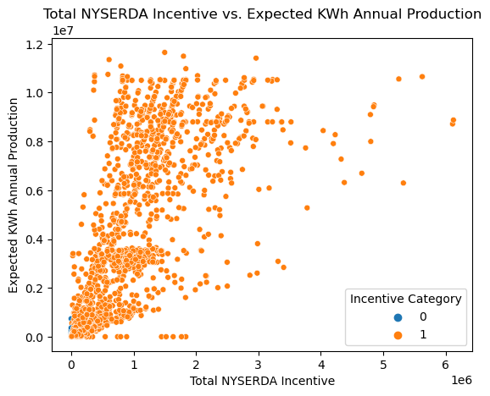
Exploratory Analysis
4. Review the relationship of the Expected KWh Annual Production variable versus the Total NYSERDA Incentive based on the category.

Slide 14
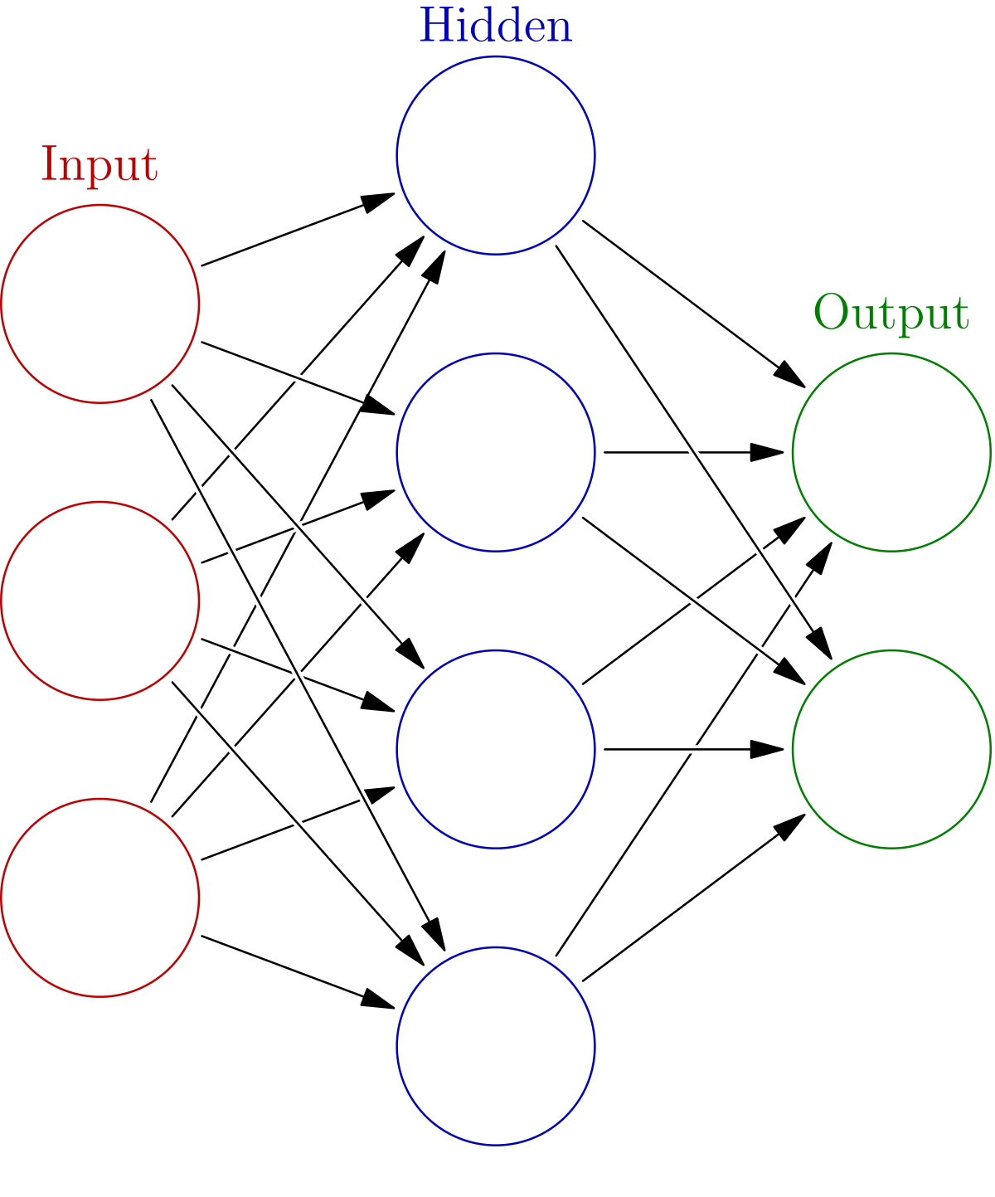
Modeling
Training:
80% of data used for training, 20% used for testing. (Roshan)
Project Cost and Expected KWh Annual Production variables used as inputs.
Incentive Category used as output variable.
(Wikipedia Contributors)

Slide 15
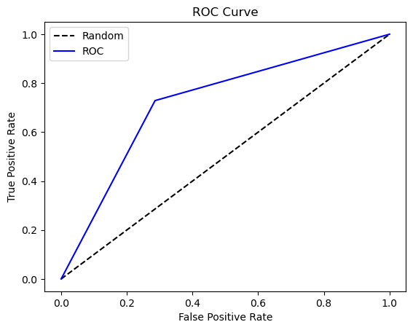
Evaluation
The model is evaluated for significance by it’s AUC score. That value is 0.7214.
True Positive Rate is plotted vs. the False Positive Rate
Area under the plotted curve is calculated to represent the data represented by the model.

Slide 16

Results

Slide 17
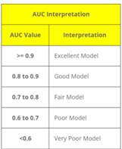
Results & Recommendations
The hypothesis was proven so the model can be recommended for use.
Caution is noted though as the AUC score is lower.
The note of caution recommends that further analysis could be useful in determining if other variables or combinations could improve the model.
(K2 Analytics)

Slide 18


Limitations
Limited Variables from Data Set
Further analysis could determine that other variables or combinations produce improved models.

Slide 19
Benefits
Example Shows 8% of Cost Covered:
Median Project Cost: $31,164
Median Incentive Amount: $2,545
Model Guidance for Low or High Dollar Amounts:
Low - $0 to $2,545
High - $2,546 to $200,000

Slide 20

Thank you
Chris Kamper
ckampe1@wgu.edu
https://www.linkedin.com/in/christopherkamper/

Slide 21
Bibliography
“Classification Accuracy & AUC ROC Curve | K2 Analytics.” K2 Analytics, 9 Aug. 2020, www.k2analytics.co.in/classification-accuracy-auc-roc-curve/. Accessed 1 Apr. 2024.
NY Open Data. “Solar Electric Programs Reported by NYSERDA: Beginning 2000.” Ny.gov, 27 June 2014, data.ny.gov/Energy-Environment/Solar-Electric-Programs-Reported-by-NYSERDA-Beginn/3x8r-34rs/about_data. Accessed 26 Mar. 2024.
Roshan, Joseph V. “Optimal Ratio for Data Splitting.” Statistical Analysis and Data Mining, vol. 15, no. 4, 4 Apr. 2022, pp. 531–538, onlinelibrary.wiley.com/doi/full/10.1002/sam.11583#:~:text=A%20commonly%20used%20ratio%20is,optimal%20for%20a%20given%20dataset., https://doi.org/10.1002/sam.11583. Accessed 12 Apr. 2024.
Wikipedia Contributors. “Neural Network (Machine Learning).” Wikipedia, Wikimedia Foundation, 6 Apr. 2024, en.wikipedia.org/wiki/Neural_network_%28machine_learning%29. Accessed 14 Apr. 2024.

